Slide 1
Ramanuj Dad
Candidate for SRE role
Contact number +91 9004481082
Email – ramanuj.in@gmail.com

Slide 2
Machine and Kubernetes
V1.29.5

Slide 3
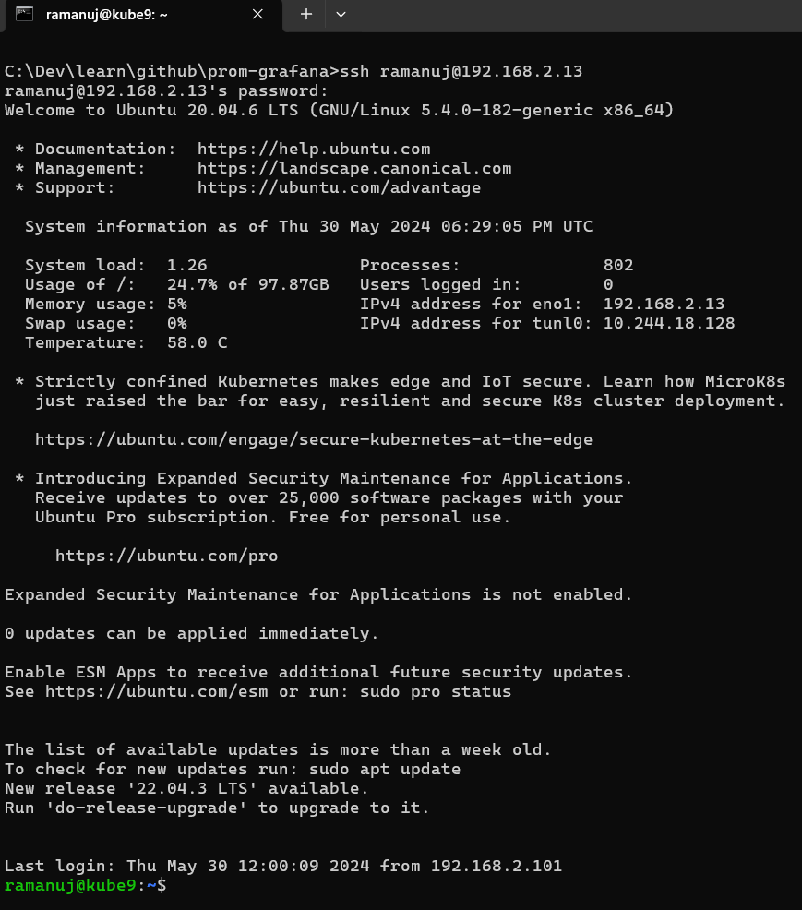
Logged into VM running Locally - ssh
Local Address: 192.168.2.13
OS: Ubuntu
Version: 20.04.6
Created using ISO: ubuntu-20.04.6-live-server-amd64.iso
Host Server: Intel(R) Xeon(R) CPU E5-2696 v2 @ 2.50GHz
Location – my home lab

Slide 4
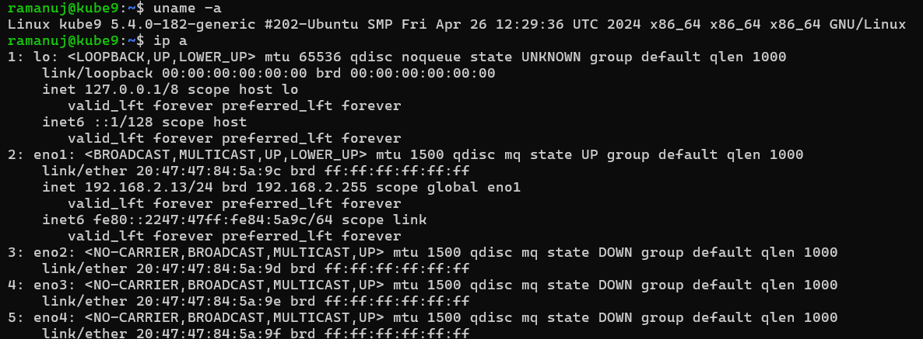
System and Network

Slide 5
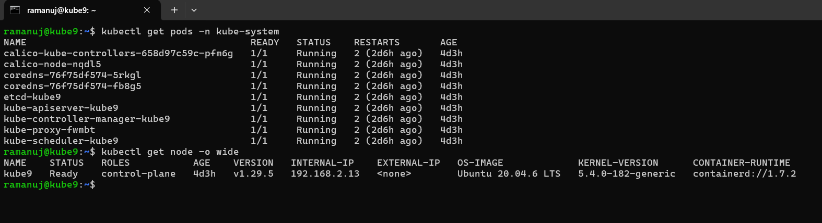
Kubernetes installed using kubeadm

Slide 6
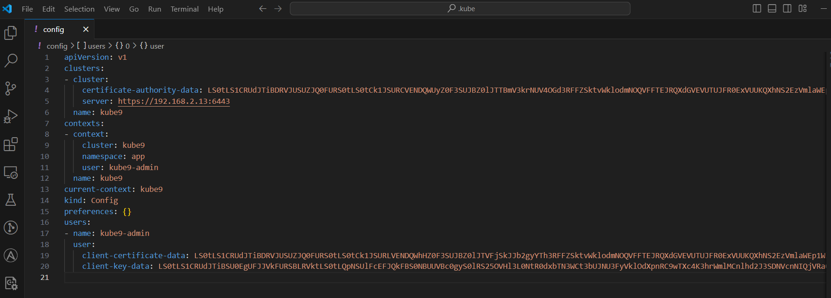
kubeconfig

Slide 7
Database Postgres
Setup with stateful set

Slide 8
Notes
Postgres being deployed first because my custom application (Java Spring boot App) requires a database as a dependency and Postgres connection details are required in the application configuration.
postgres namespace setup and statefulset deployment.
Next screenshot shows all resources created into postgres namespace.
There are multiple resources all details can be found in GitHub repo on this path - prom-grafana\kubernetes\1-postgres
Accordingly all code in the GitHub repo for the entire deck

Slide 9
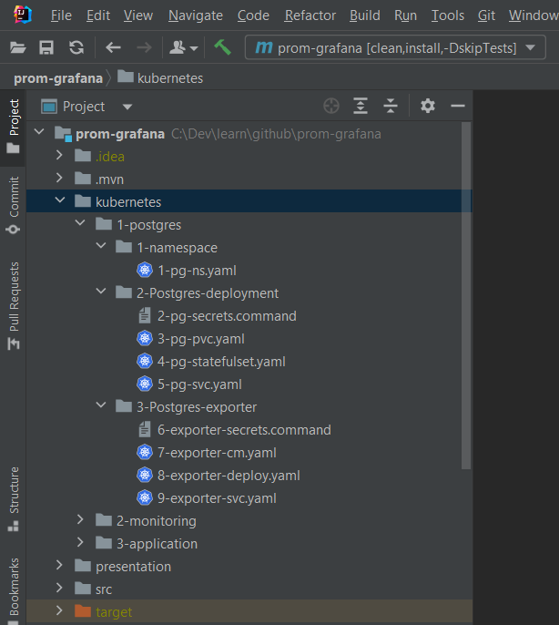
Directories in my IDE for Postgres

Slide 10
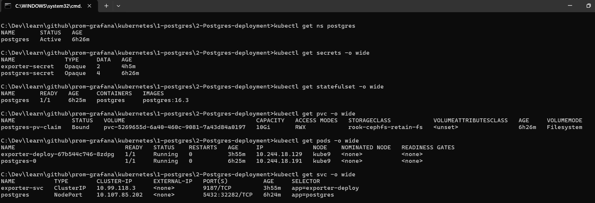
Database deployment

Slide 11
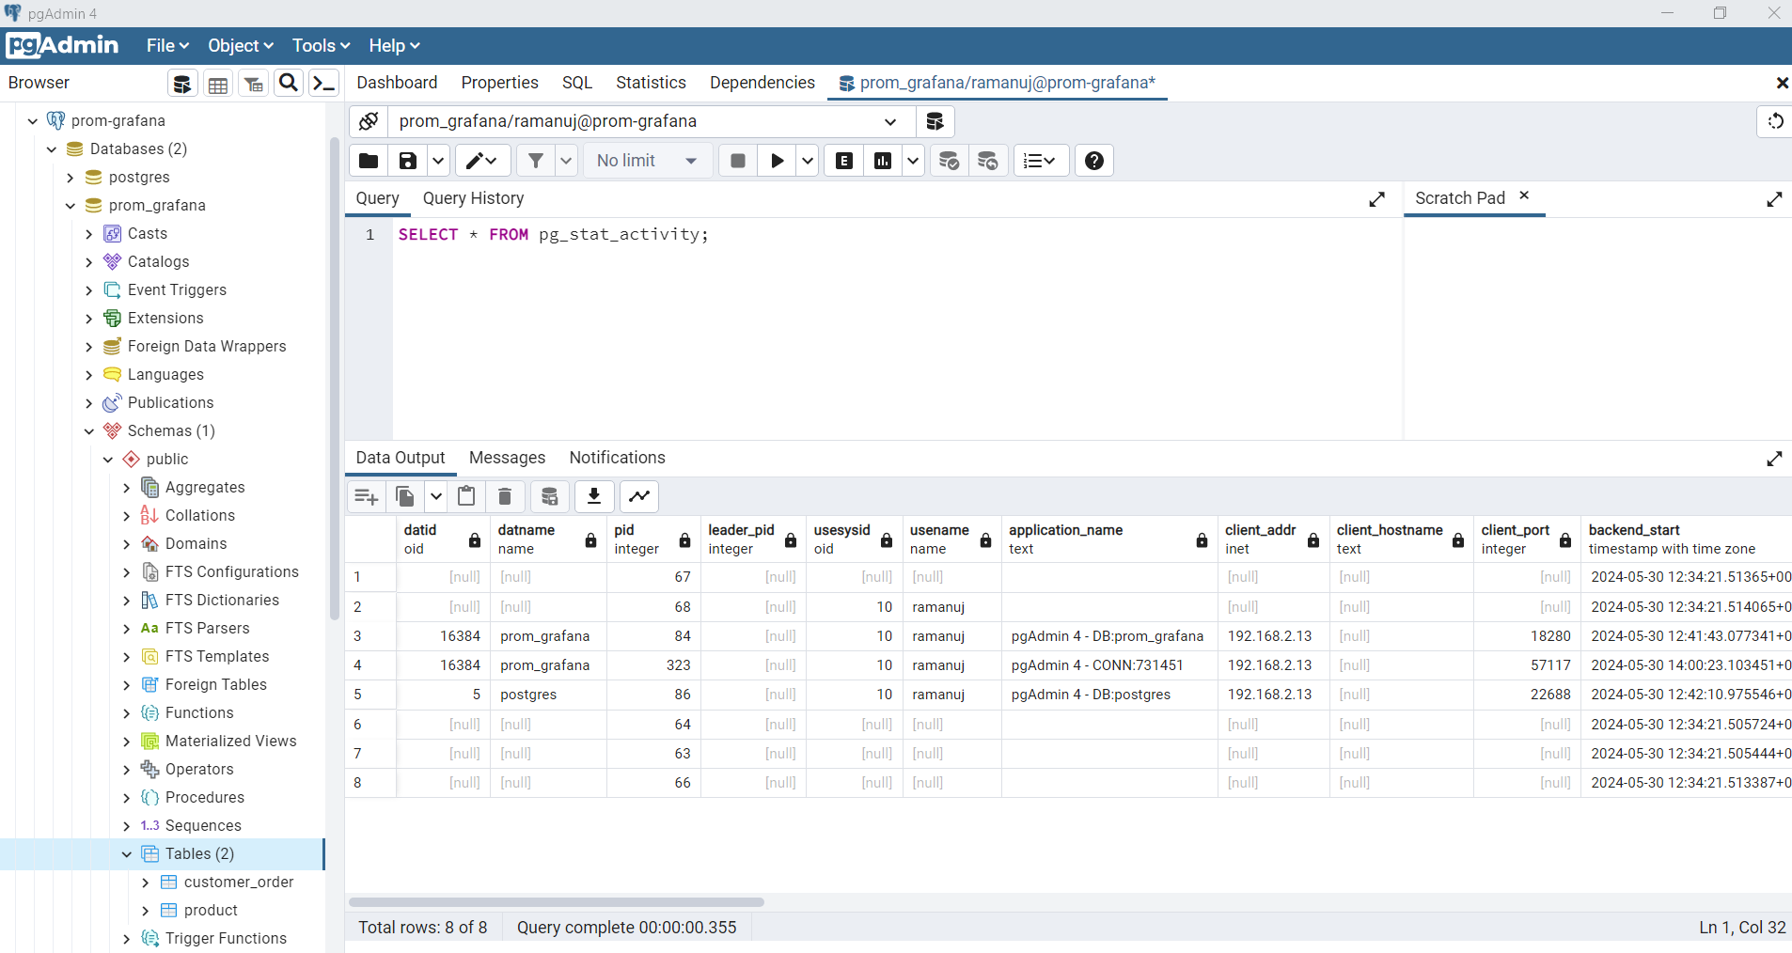
Database connect on Nodeport using PGADMIN from local

Slide 12
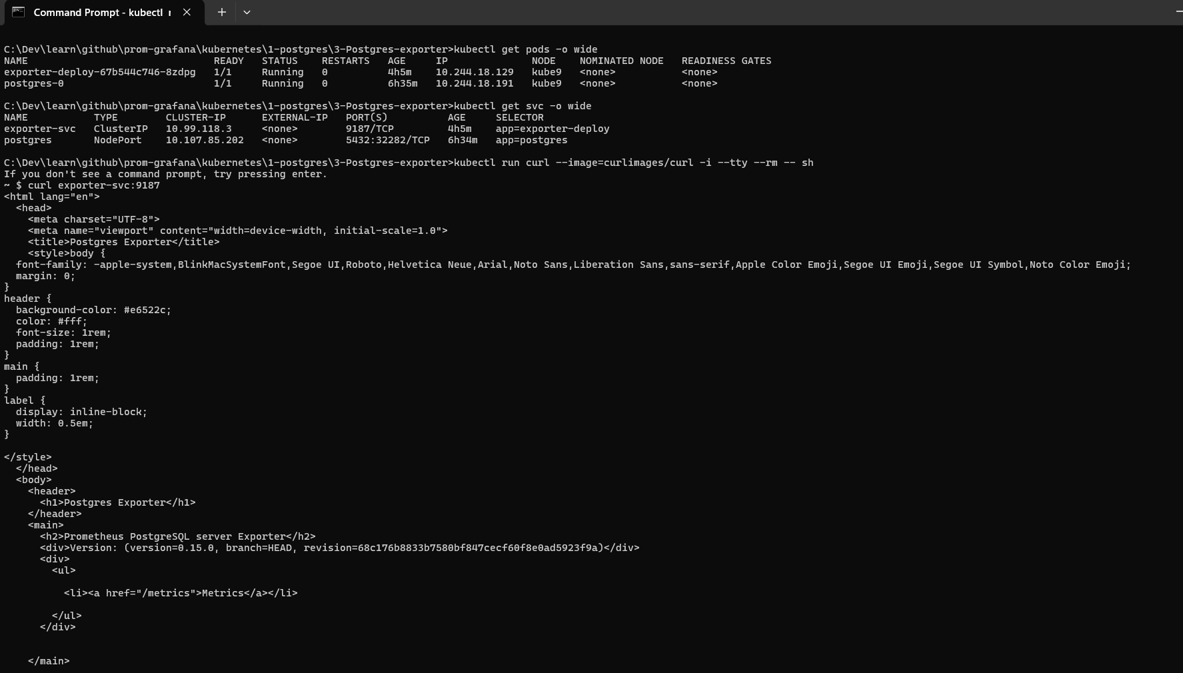
Postgres Exporter for Prom metrics Running

Slide 13
Prometheus and Grafana
Latest docker image used - Setup

Slide 14
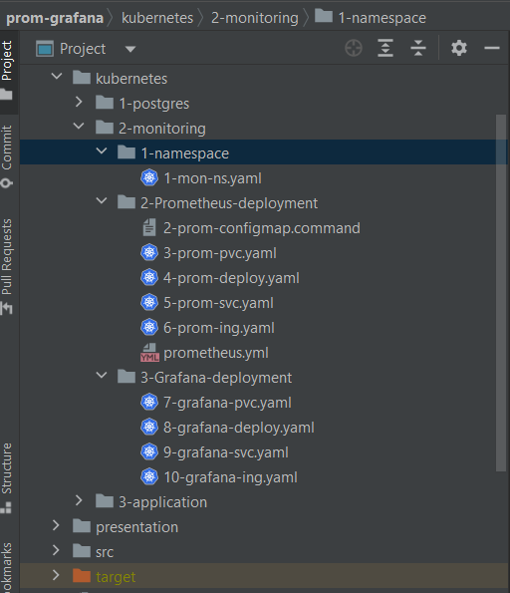
Monitoring namespace & Dir in my IDE

Slide 15
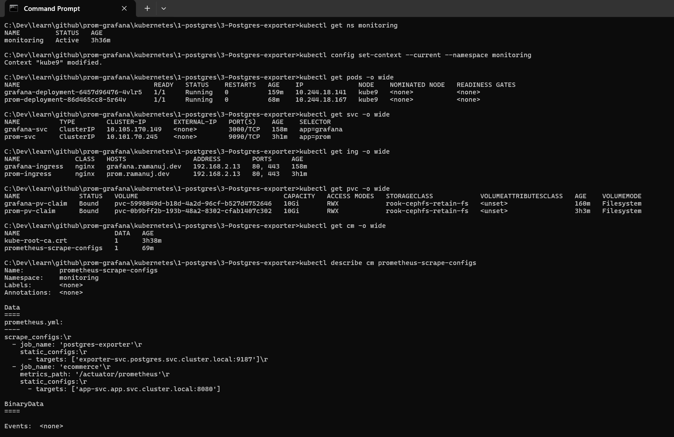
Prom and Grafana Running with Config

Slide 16
Docker Build Custom Application
Spring boot Java 17 App with exposed Prometheus Metrics endpoints and app configured

Slide 17
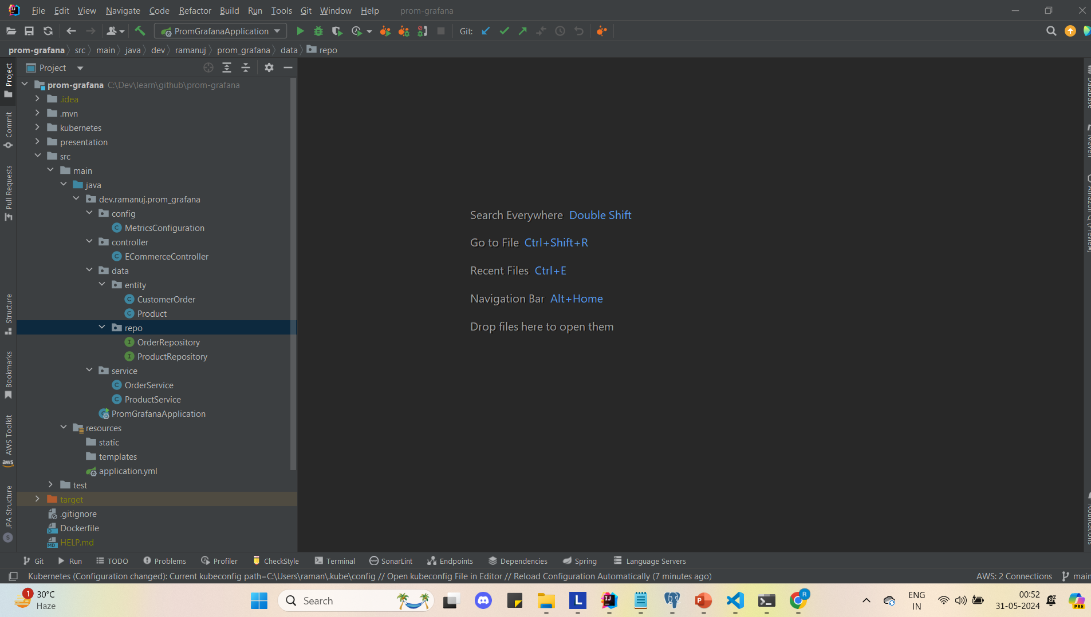
App in My IDE – Code pushed to GitHub

Slide 18
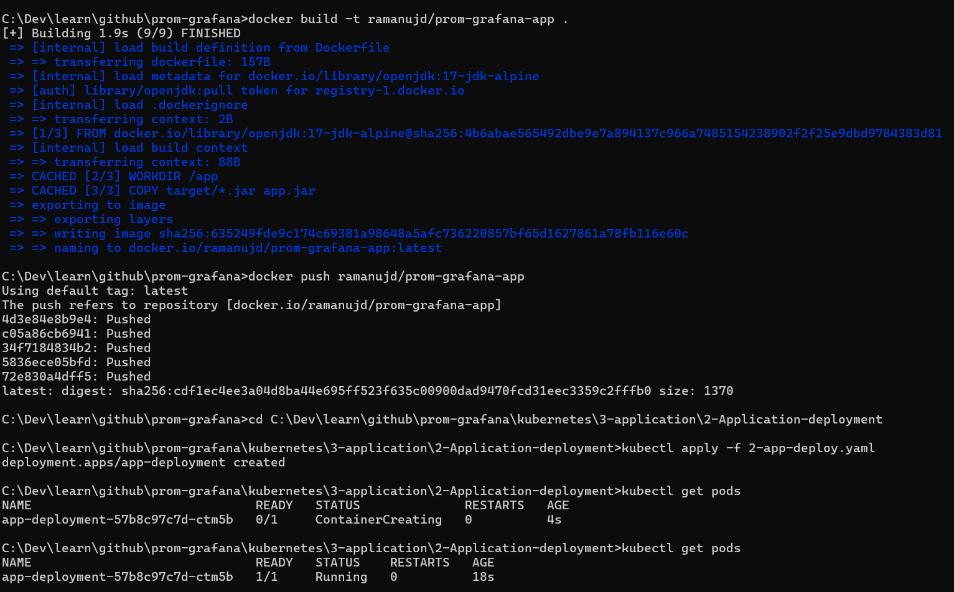

Slide 19
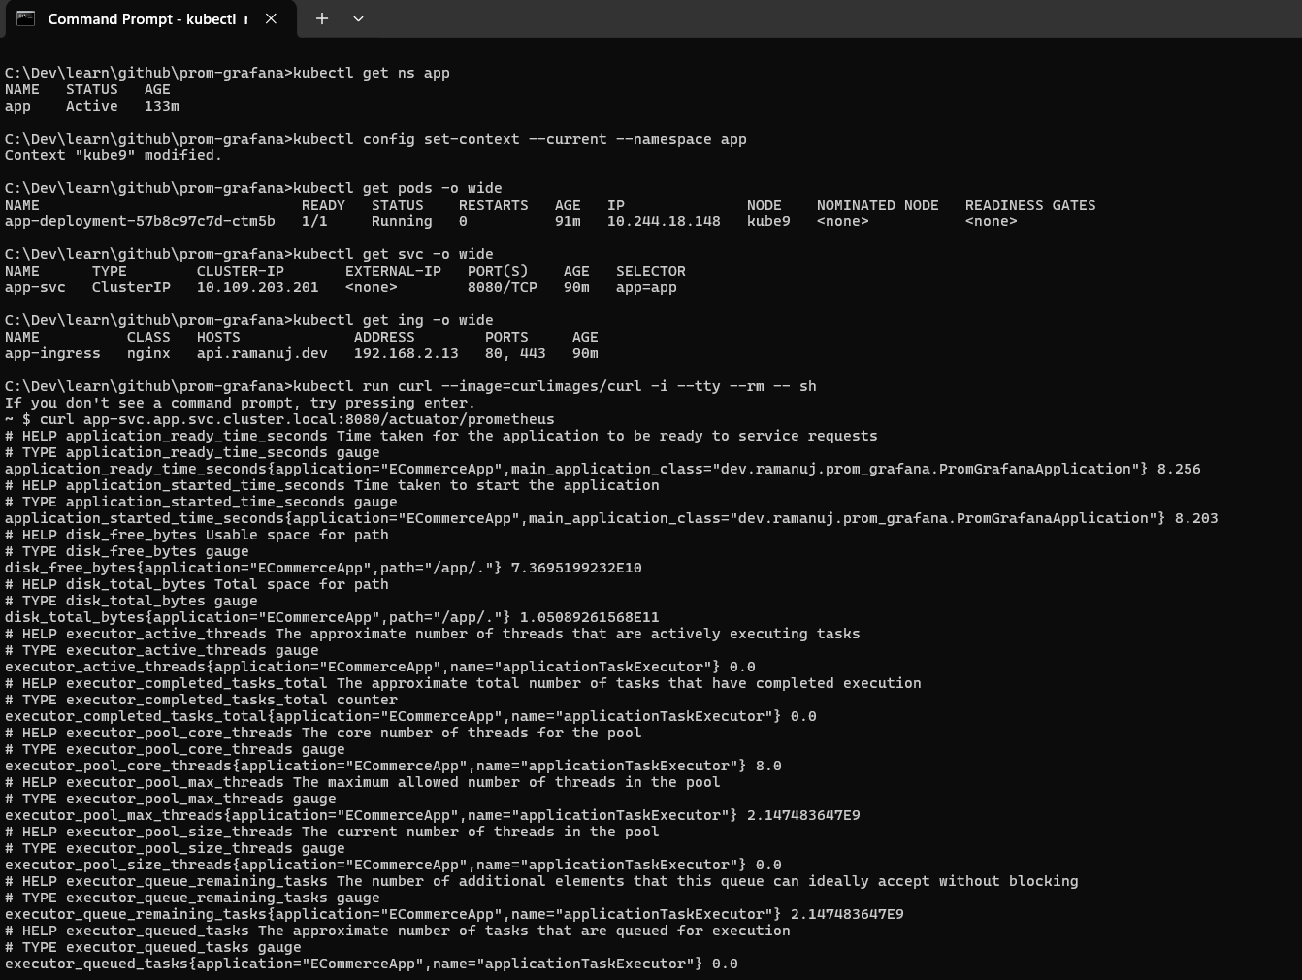
Custom Application with metrics by curl

Slide 20
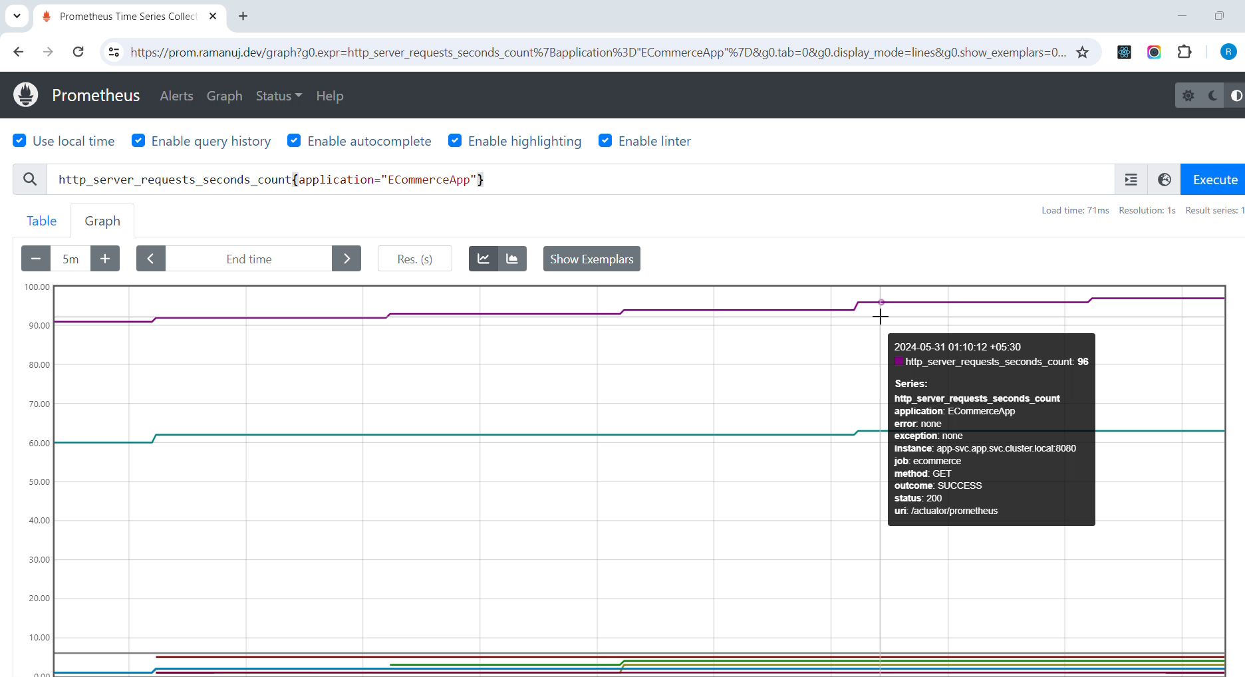
Prom UI showing custom metrics

Slide 21
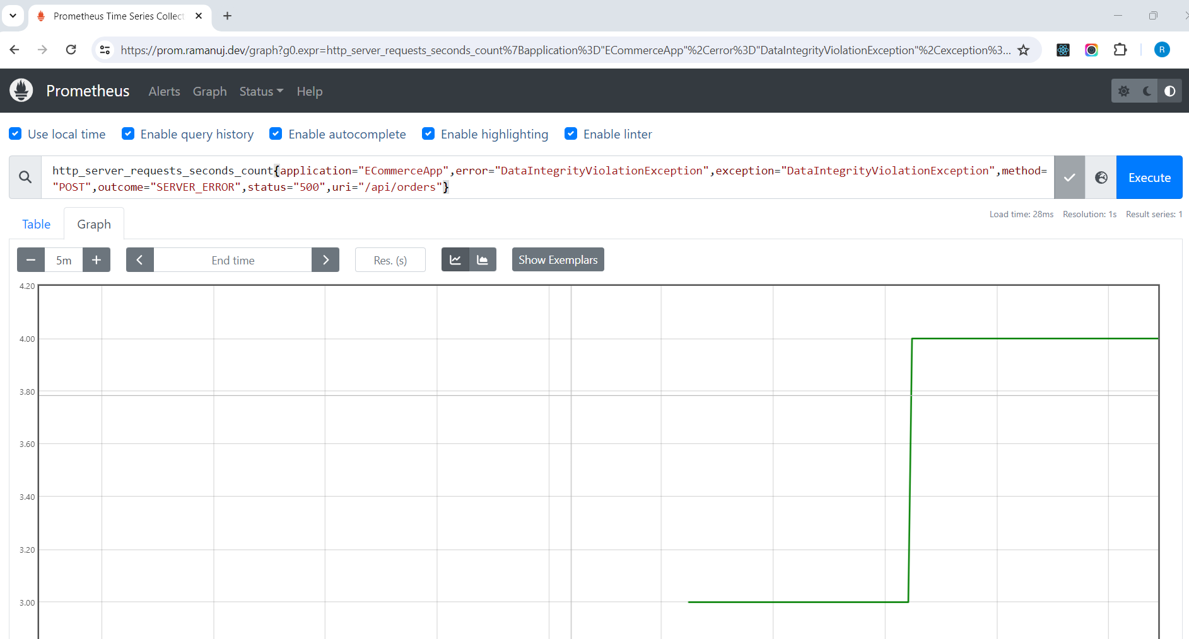
Prom UI query for custom error metrics

Slide 22
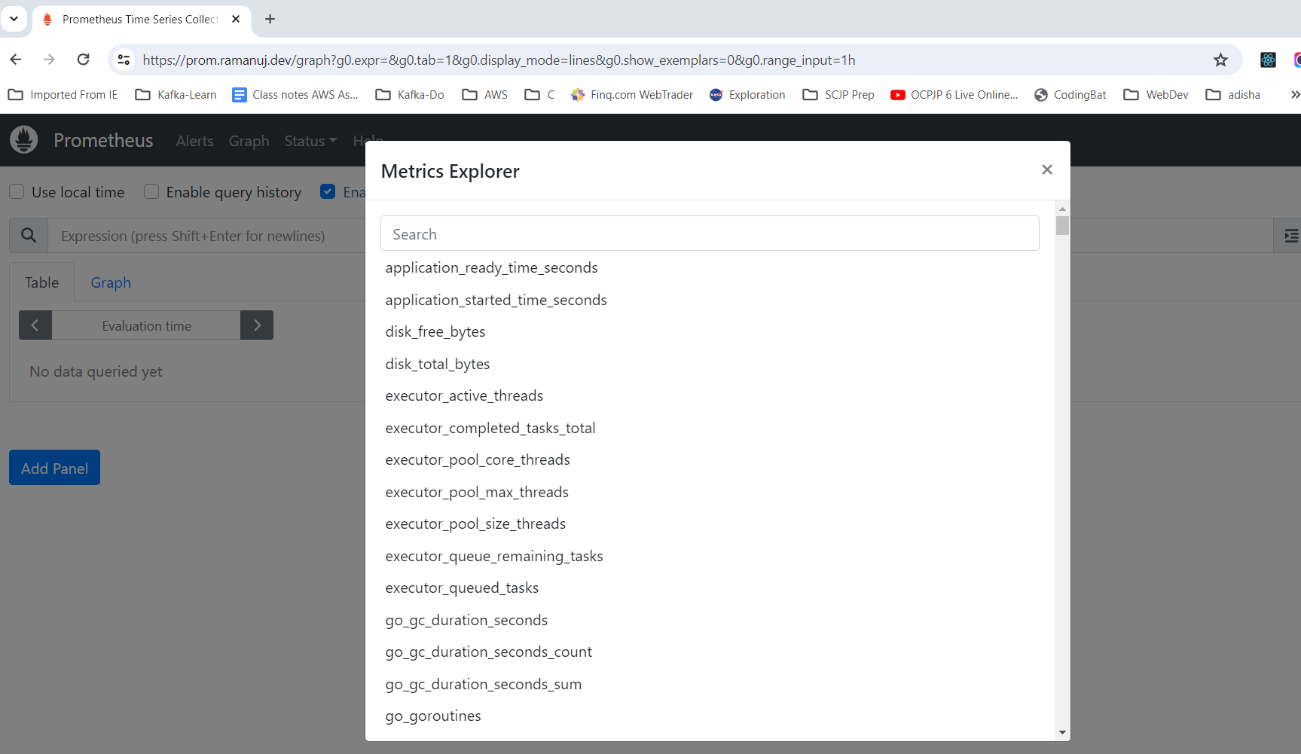
Showing metrics available
All Metrics are
Available
Postgres DB
Custom App
Spring App

Slide 23
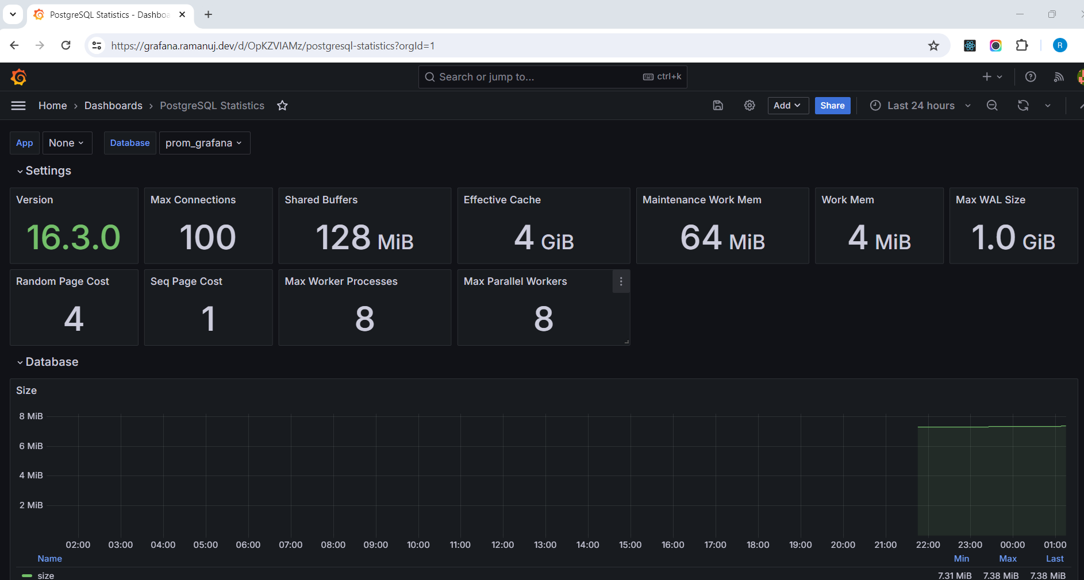
Postgres metrics in Grafana

Slide 24
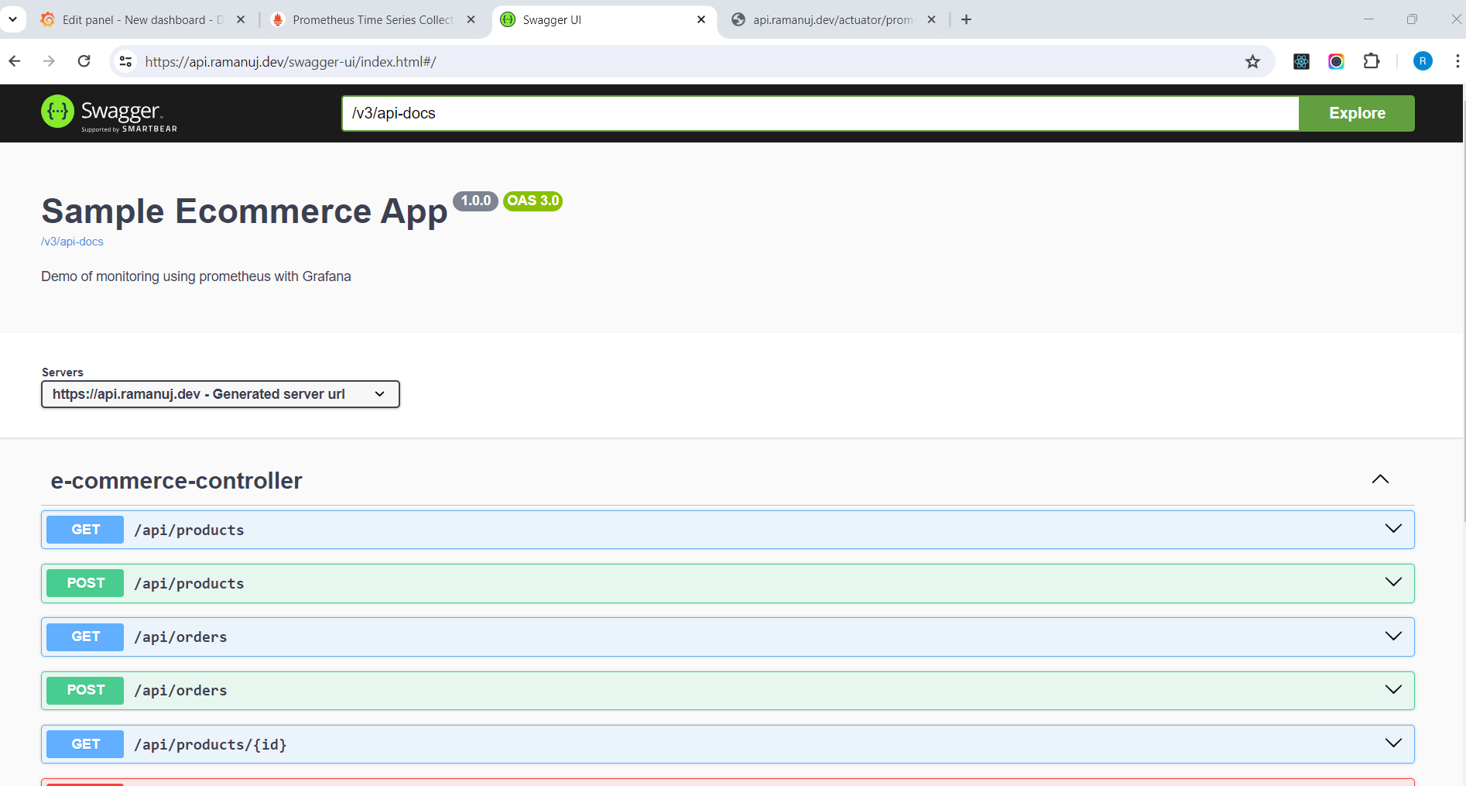
API Dashboard for custom app

Slide 25
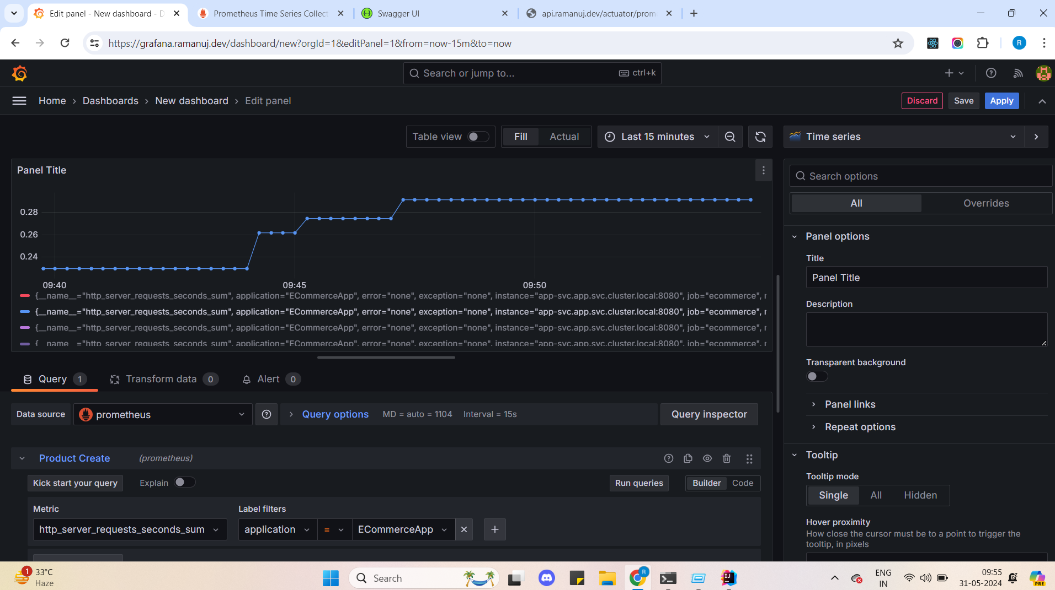
Each API call from custom application -

Slide 26
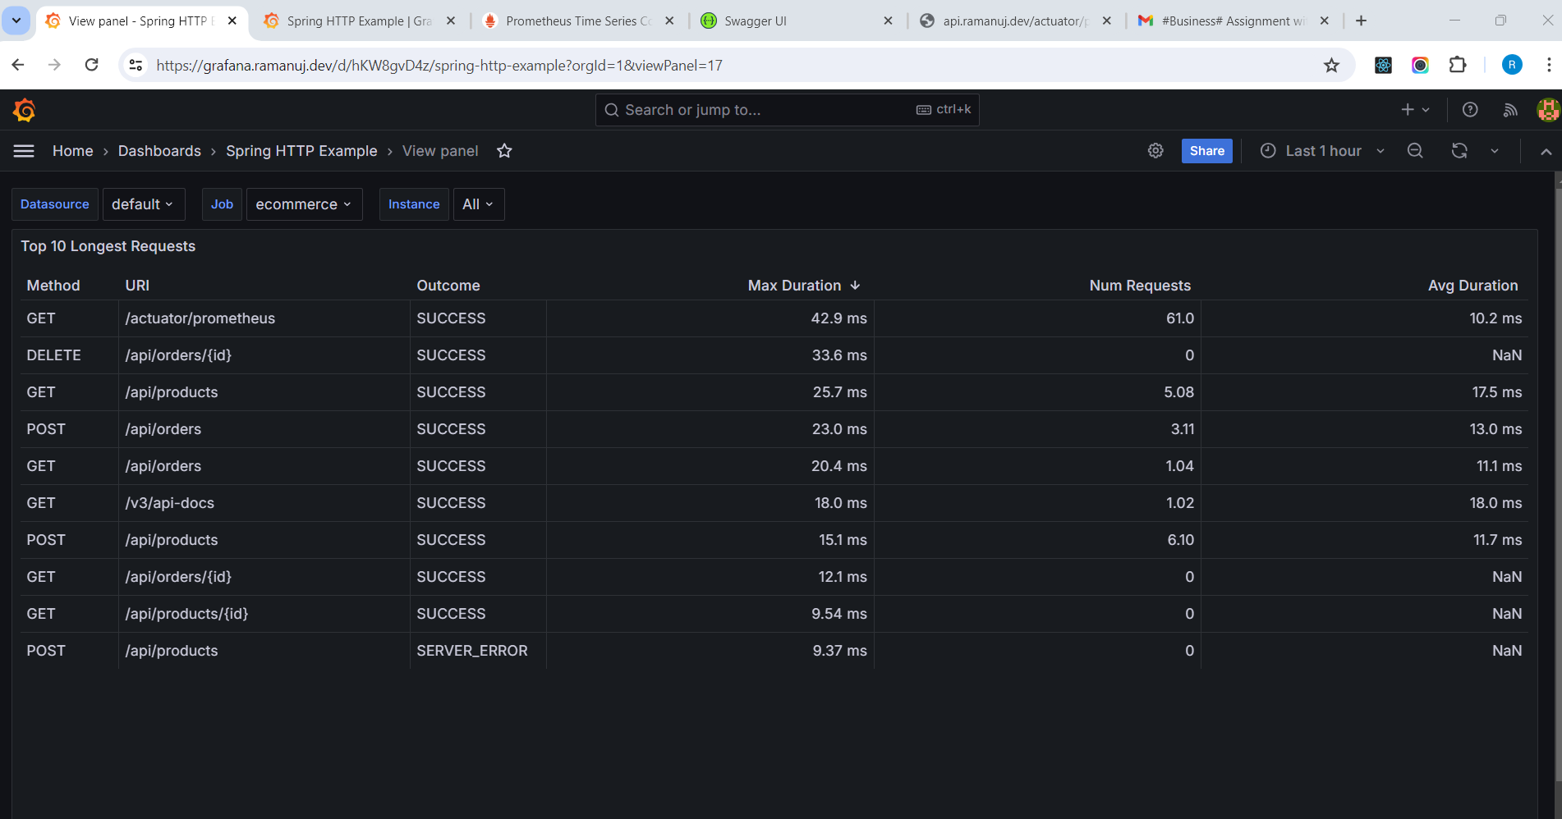
HTTP Status Codes and response time

Slide 27
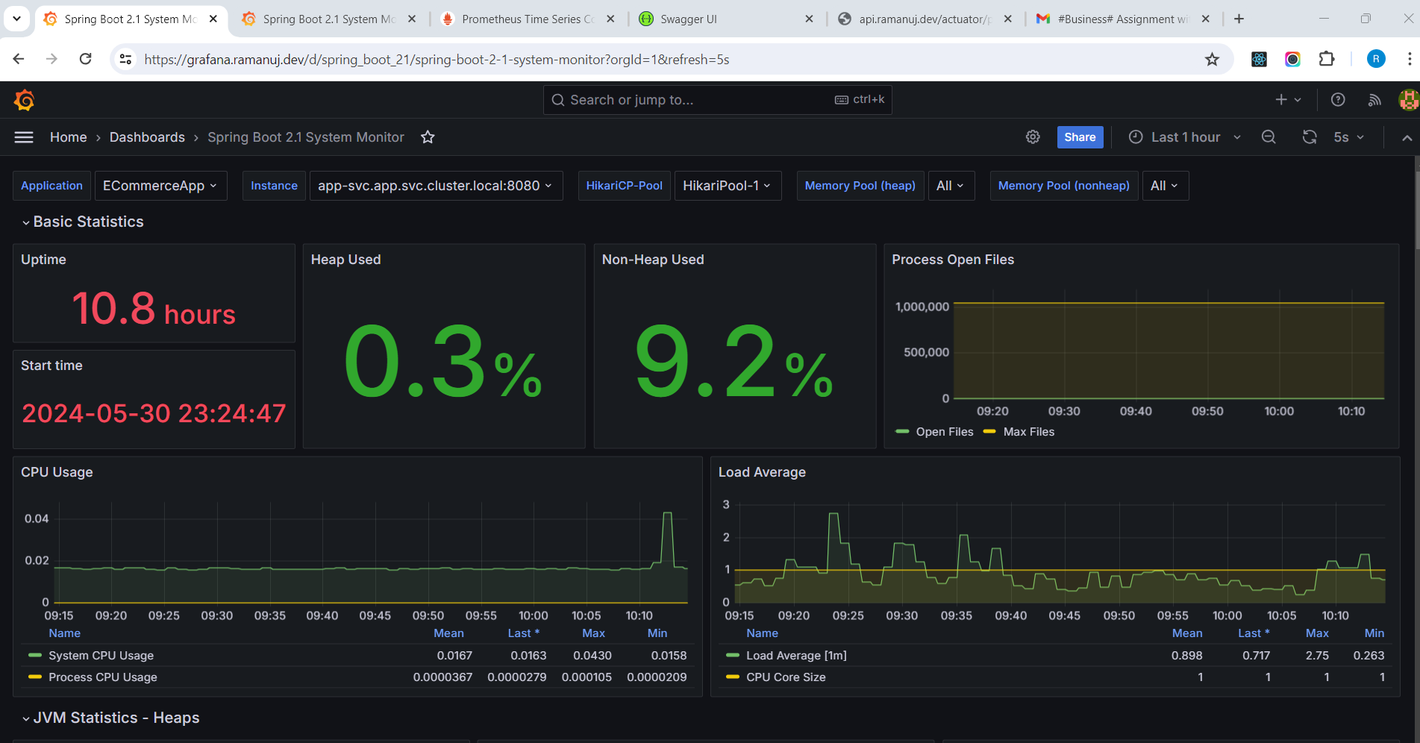
App Container Monitoring

Slide 28
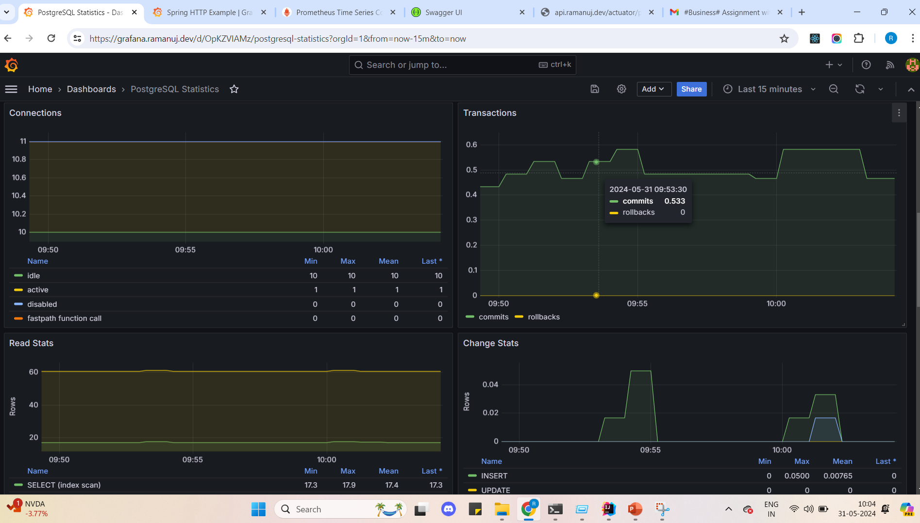
Database commits as API being used

Slide 29
Important links
Database URL - postgres.postgres.svc.cluster.local:5432 (not public)
Below are all public URL for your verification and validation
Prometheus URL - https://prom.ramanuj.dev/
Grafana URL - https://grafana.ramanuj.dev/
Custom App Prometheus endpoint - https://api.ramanuj.dev/actuator/prometheus
Database Prometheus endpoint - https://postgres.ramanuj.dev/metrics
Custom APP Rest API - https://api.ramanuj.dev/swagger-ui/index.html

Slide 30
GitHub Repo Link – Please verify
https://github.com/ramanujd/prom-grafana
Please verify all codebases of the above repo. All work is created for this assignment.

